Slide 1
Lecture 13c - Classification Model Evaluation

Slide 2
Why Model Evaluation
We have looked at a number of classification model algorithms: Decision Trees, Neural Nets, Logistic Regression, etc.
So far the only criteria we used to judge them on was absolute error
Tonight we will discuss a more nuanced approach
We will also discuss how it can lead to model improvements

Slide 3
Gain Chart
Gain charts are best described with an example.
Suppose we are trying to reach a population of people that would buy a product and that on average 50% of the population would buy
If your model is ordered, such that the first 10 people identified by the model have 80% buy rate, then next 20, 70% etc. than the model has a high ‘gain’ and outperforms a random sampling
See chart on next slide

Slide 4
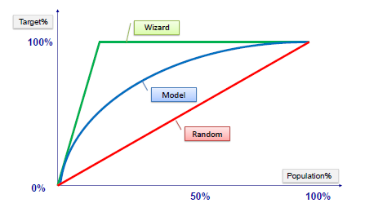
Gain Chart (2)

Slide 5
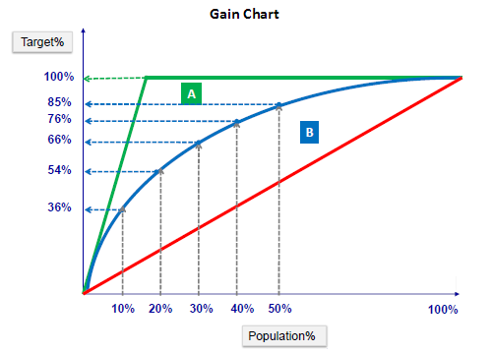
Gain Chart (3)

Slide 6
Lift Chart
Lift chart is similar.
Again, we assume a certain level of positive response from the average population
A lift chart would show the top 10 percent of people picked by the model would have 3 times as many with a positive response
The top 20% would have 2.5 times as many positive responses, etc.
See chart on next slide

Slide 7
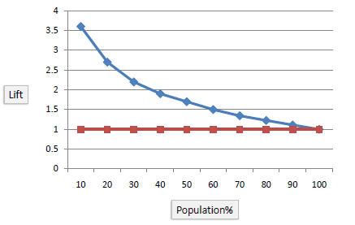
Lift Chart (2)

Slide 8
False-Positives; False-Negatives and Error Rates
We have used the census data over and over again to test various algorithms.
We wished to predict whether someone made more than $50k in 1994 based on a number of attributes
Since we had testing data with the actual income, we knew the percentage that we predicted right or wrong
The best we did was 14% error
But note there are really two ways to be right and two ways to be wrong
In other words there are
  true positives: model correctly predicted >50k
  false positives: model incorrectly predicted > 50k
  true negatives: model correctly predicted < 50k
  false negatives: model incorrectly predicted < 50k
These statistics can be used to evaluate and in some cases improve the model

Slide 9
The Confusion Matrix
The standard display for the stats on the previous page is called a “Confusion Matrix”
It’s named this because it is an easy way to discern if the model is ‘confusing’ two classes of objects in a classification model.
It is also sometimes known as a contingency table, an error matrix, or a matching matrix

Slide 10
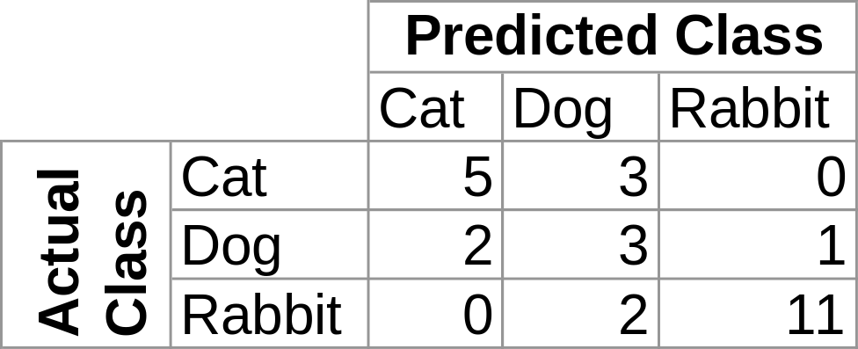
Example Confusion Matrix
This matrix describes the results of a model that predicts whether an animal is a dog, cat, or rabbit
Of the 8 actual cats, the model ‘confused’ 3 for dogs. Of the 6 actual dogs, the model ‘confused’ 2 for cats and 1 for a rabbit

Slide 11
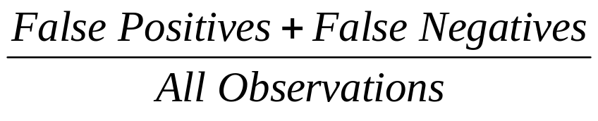
Why do we care?
Error Rate =
Not all errors are created equal. Sometimes false positives are less problematic than false negatives, or vice versa
Consider a bank making loans that average $10k each. Rejecting a loan costs about $25 in wasted time and paperwork. A loan that is paid in full is worth about $2000 in multiple year interest and fees. A loan that defaults costs $3000 on average
If we are predicting credit risk where 1 is a good credit risk and 0 is a bad credit risk, then a false positive could cost $3000, but a false negative only costs $25

Slide 12
Why do we care (2)?
Similarly if we are identifying cancer risks in tumor images:
  A false positive means the model predicts cancer, so a Doctor looks at the image more closely or you have another test to confirm cancer
  A false negative however is very problematic. It means the machine has cleared you when you actually need treatment.
  Therefore a model that is 90% accurate but with false negatives is less valuable than a model that is 80% accurate and has only false positives.

Slide 13
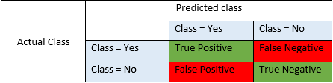
F1 Score, Precision-Recall etc.
Accuracy - Accuracy is the most intuitive performance measure and it is simply a ratio of correctly predicted observation to the total observations. One may think that, if we have high accuracy then our model is best. Yes, accuracy is a great measure but only when you have symmetric datasets where values of false positive and false negatives are almost same. Therefore, you have to look at other parameters to evaluate the performance of your model. Accuracy = TP+TN/TP+FP+FN+TN
Precision - Precision is the ratio of correctly predicted positive observations to the total predicted positive observations. High precision relates to the low false positive rate. Precision = TP/TP+FP
Recall (Sensitivity) - Recall is the ratio of correctly predicted positive observations to the all observations in actual class - yes. Recall = TP/TP+FN
F1 score - F1 Score is the weighted average of Precision and Recall. Therefore, this score takes both false positives and false negatives into account. Intuitively it is not as easy to understand as accuracy, but F1 is usually more useful than accuracy, especially if you have an uneven class distribution. Accuracy works best if false positives and false negatives have similar cost. If the cost of false positives and false negatives are very different, it’s better to look at both Precision and Recall. F1 Score = 2*(Recall * Precision) / (Recall + Precision)
Those who had text mining will recall we used F1 score to determine sentiment contest winners.

Slide 14
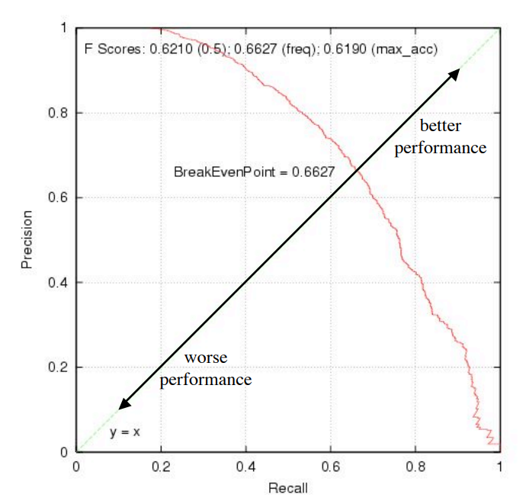
F1 Score, Precision-Recall etc (2).
Note it’s possible to increase precision at the expense of recall and vice-versa
The point where precision==recall is called the break-even point.
Example F-Score plot from https://www.cs.cornell.edu/courses/cs578/2003fa/performance_measures.pdf

Slide 15
ROC Plot and ROC Area https://www.cs.cornell.edu/courses/cs578/2003fa/performance_measures.pdf
Receiver Operator Characteristic
Developed in WWII to statistically model false positive and false negative detections of radar operators
Better statistical foundations than most other measures
Standard measure in medicine and biology
Becoming more popular in ML

Slide 16
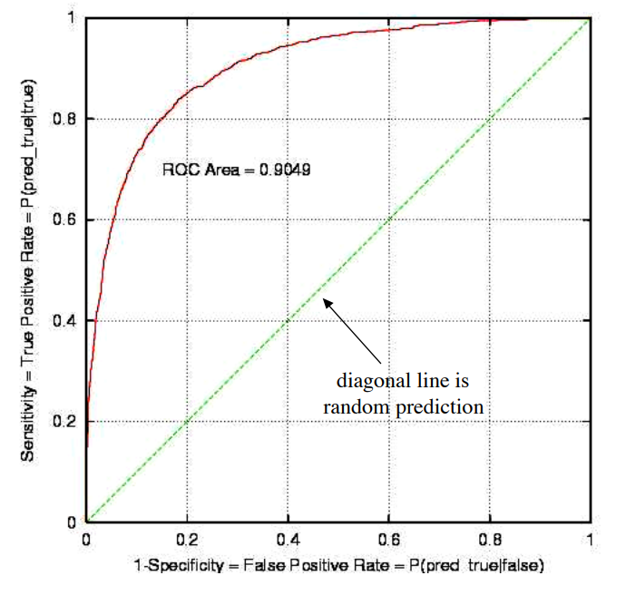
Sample ROC Plot https://www.cs.cornell.edu/courses/cs578/2003fa/performance_measures.pdf

Slide 17
Interpreting ROC Plot https://www.cs.cornell.edu/courses/cs578/2003fa/performance_measures.pdf
ROC Area:
– 1.0: perfect prediction
– 0.9: excellent prediction
– 0.8: good prediction
– 0.7: mediocre prediction
– 0.6: poor prediction
– 0.5: random prediction
– <0.5: something wrong!

Slide 18
Interpreting ROC Plot (2) https://www.cs.cornell.edu/courses/cs578/2003fa/performance_measures.pdf
Slope is non-increasing
Each point on ROC represents different tradeoff (cost ratio) between false positives and false negatives
Slope of line tangent to curve defines the cost ratio
ROC Area represents performance averaged over all possible cost ratios
If two different model’s ROC curves do not intersect, one method dominates the other
If two ROC curves intersect, one method is better for some cost ratios (applications), and other method is better for other cost ratios

Slide 19
Summary
Overall error rate or accuracy is not always sufficient
Recall can be increased at the expense of Precision and vice-versa
Choose the accuracy measure appropriate for your application
  e.g. low false negatives (high recall) is very important in medical applications
  But low false positives (high precision) is very important in credit worthiness predictions
  F-Score measures overall performance when recall and precision are equally important
  ROC curves similarly, but more often found in medical and biology articles than in Machine Learning articles
Don’t forget to go to R

